Slide 1
Digital Portfolio
STUDENT NAME: Meenakshi.S
REGISTER NO AND NMID: 21024u18048/0FC4FD922F04C019755442B72906D300
DEPARTMENT: Bsc Computer Science
COLLEGE: Sri Akilandeswari Womens college-Wandwash.
Thiruvallur University.

Slide 2
PROJECT TITLE
Student Digital Porttfolio Using HTML,CSS,JS

Slide 3


AGENDA
Problem Statement
Project Overview
End Users
Tools and Technologies
Portfolio design and Layout
Features and Functionality
Results and Screenshots
Conclusion
Github Link
3/21/2024 Annual Review

Slide 4

PROBLEM STATEMENT
~ A traditional Resume is not for enough to effectively show case skills and my Projects.many students and professionals lack a structured online presence to highlight their work
~ There is a need for a Personal Portfolio website where I can present my skills,projects,and contact details in a professionl and attractive way

Slide 5

PROJECT OVERVIEW
~ This project is a personal portfolio website designed to showcase my skills, projects, and contact information in a professional way.
~ The website includes sections such as About Me, Skills, Projects, and Contact, providing an interactive and user-friendly platform to present my work.
~ It highlights my technical abilities, problem-solving skills, and achievements, while also offering an easy way for recruiters or collaborators to reach me.

Slide 6

WHO ARE THE END USERS?
~Recruiters / Hiring Managers 👔
They will check your portfolio to evaluate your skills, projects, and suitability for internships or jobs.
~College Faculty / Evaluators 🎓
They might review it as part of your academic projects, assignments, or viva.
Peers & Collaborators 🤝
Other students or developers who may want to collaborate with you on projects.
~Potential Clients (Freelance Work) 💼
People who want to hire you for building websites or small applications.
~General Audience / Visitors 🌍
Anyone interested in your work.

Slide 7

TOOLS AND TECHNIQUES
Tools
HTML – for creating the structure of the website.
CSS – for styling and layout.
JavaScript – for adding interactivity.
VS Code – for writing code.
Web Browser – for testing the website.
Techniques
Responsive Design – to make the site work on mobile and desktop.
Navigation Menu – to move between sections easily.
Contact Form – to allow visitors to send messages.
Project Showcase – to display skills and projects neatly.

Slide 8
POTFOLIO DESIGN AND LAYOUT
Portfolio Design and Layout
The portfolio website is designed with a clean and user-friendly layout. It is divided into the following main sections:
Header – Contains the name, a short title, and a navigation bar with links to different sections.
2.About Section – Includes a profile picture and a short introduction.
3.Skills Section – Lists technical and personal skills in a structured way.
4.Projects Section – Highlights sample projects with titles and descriptions.
5.Contact Section – Provides a form where visitors can send messages.
6.Footer – Displays copyright information.

Slide 9
FEATURES AND FUNCTIONALITY
Features
Clean and simple design for easy navigation.
Responsive layout that works on mobile, tablet, and desktop.
Navigation bar to jump between sections.
Profile section with image and introduction.
Skills section to highlight technical abilities.
Projects section to showcase completed work.Contact form for visitors to send messages.
Functionality
Navigation links take the user to different sections smoothly.
Contact form collects user details (name, email, message).
Projects are displayed in a structured format with descriptions.
Responsive design automatically adjusts the layout based on screen size.

Slide 10
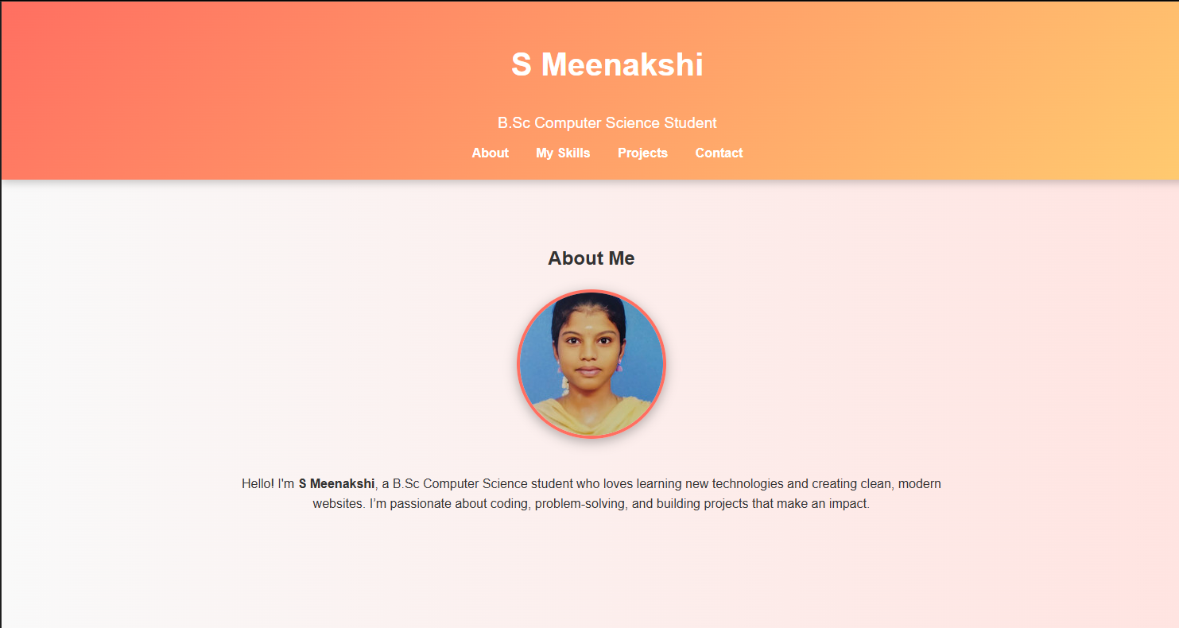
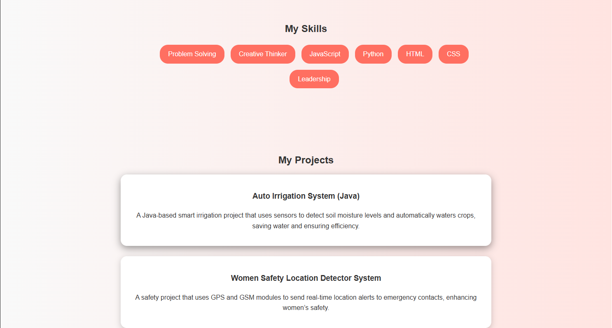
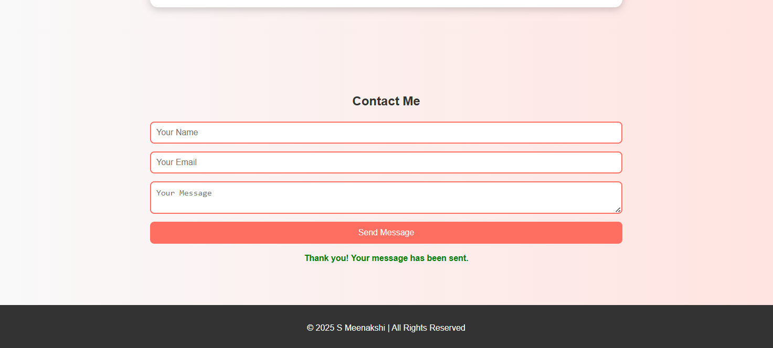

RESULTS AND SCREENSHOTS
1) Screenshots of each section.
2) Before vs After (plain HTML--> with CSS & JS).
3/21/2024 Annual Review

Slide 11
CONCLUSION
The portfolio website provides a professional platform to showcase my skills, projects, and achievements in a simple and interactive way. It helps create a digital identity, making it easier for recruiters, teachers, and collaborators to know more about me. The project also improved my knowledge of HTML, CSS, and JavaScript, and gave me hands-on experience in web design and development.

